Slide 1
Enterprise-class networking
Notes:
Information in this document, including URL and other Internet Web site references, is subject to change without notice. Unless otherwise noted, the example companies, organizations, products, domain names, e-mail addresses, logos, people, places, and events depicted herein are fictitious, and no association with any real company, organization, product, domain name, e-mail address, logo, person, place or event is intended or should be inferred. Complying with all applicable copyright laws is the responsibility of the user. Without limiting the rights under copyright, no part of this document may be reproduced, stored in or introduced into a retrieval system, or transmitted in any form or by any means (electronic, mechanical, photocopying, recording, or otherwise), or for any purpose, without the express written permission of Microsoft Corporation.
Microsoft may have patents, patent applications, trademarks, copyrights, or other intellectual property rights covering subject matter in this document. Except as expressly provided in any written license agreement from Microsoft, the furnishing of this document does not give you any license to these patents, trademarks, copyrights, or other intellectual property.
The names of manufacturers, products, or URLs are provided for informational purposes only and Microsoft makes no representations and warranties, either expressed, implied, or statutory, regarding these manufacturers or the use of the products with any Microsoft technologies. The inclusion of a manufacturer or product does not imply endorsement of Microsoft of the manufacturer or product. Links may be provided to third party sites. Such sites are not under the control of Microsoft and Microsoft is not responsible for the contents of any linked site or any link contained in a linked site, or any changes or updates to such sites. Microsoft is not responsible for webcasting or any other form of transmission received from any linked site. Microsoft is providing these links to you only as a convenience, and the inclusion of any link does not imply endorsement of Microsoft of the site or the products contained therein.
© 2017 Microsoft Corporation. All rights reserved.
Microsoft and the trademarks listed at https://www.microsoft.com/en-us/legal/intellectualproperty/Trademarks/Usage/General.aspx are trademarks of the Microsoft group of companies. All other trademarks are property of their respective owners.

Slide 2
Abstract and learning objectives
In this whiteboard design session, you will look at the process of configuring an enterprise-class network within Azure. Your design will include technologies to connect multiple virtual networks, as well as using capabilities such as routing to deploy network virtual appliances such as firewalls to secure your deployment.
At the end of this whiteboard design session, you will be better able to design solutions using Azure Networking features and capabilities.

Slide 3
Step 1: Review the customer case study
Outcome
Analyze your customer needs.
Timeframe
15 minutes

Slide 4
Customer situation Woodgrove Financial Services
In business for over 75 years and is a well-known and respected name brand in the financial industry
Historically risk-averse; helping them survive several financial downturns
Started in the US, but expanded into Mexico 20 years ago
Today they have 224 branches in the US and 64 in Mexico

Slide 5
Customer situation (continued)
Headquartered in Chicago, IL
US branches in several states over the north central US
Mexico-based branches are in Mexico City and in the surrounding cities

Slide 6
Customer situation (continued)
New president brought on to:
Modernize the image of the bank
Drive efficiencies through use of modern technologies
Lower capital costs
Refocus Woodgrove on its core business

Slide 7
Customer situation (continued)
Ten years ago went through a major upgrade of their Ethernet core and WAN between two US datacenters:
Plano, TX
Chicago, IL
Mexico datacenter located in Mexico City

Slide 8
Customer situation (continued)
Woodgrove Financial Services want to run a marketing web application on the cloud as a pilot basis.
To support their strategy of embracing cloud technologies, network and security team have agreed not to redirect Internet traffic via their on-premises security gateway for this deployment. They are looking for a cloud-native security solution. This is something they want to pilot on a low risk workload and it requires a separate cloud deployment.

Slide 9
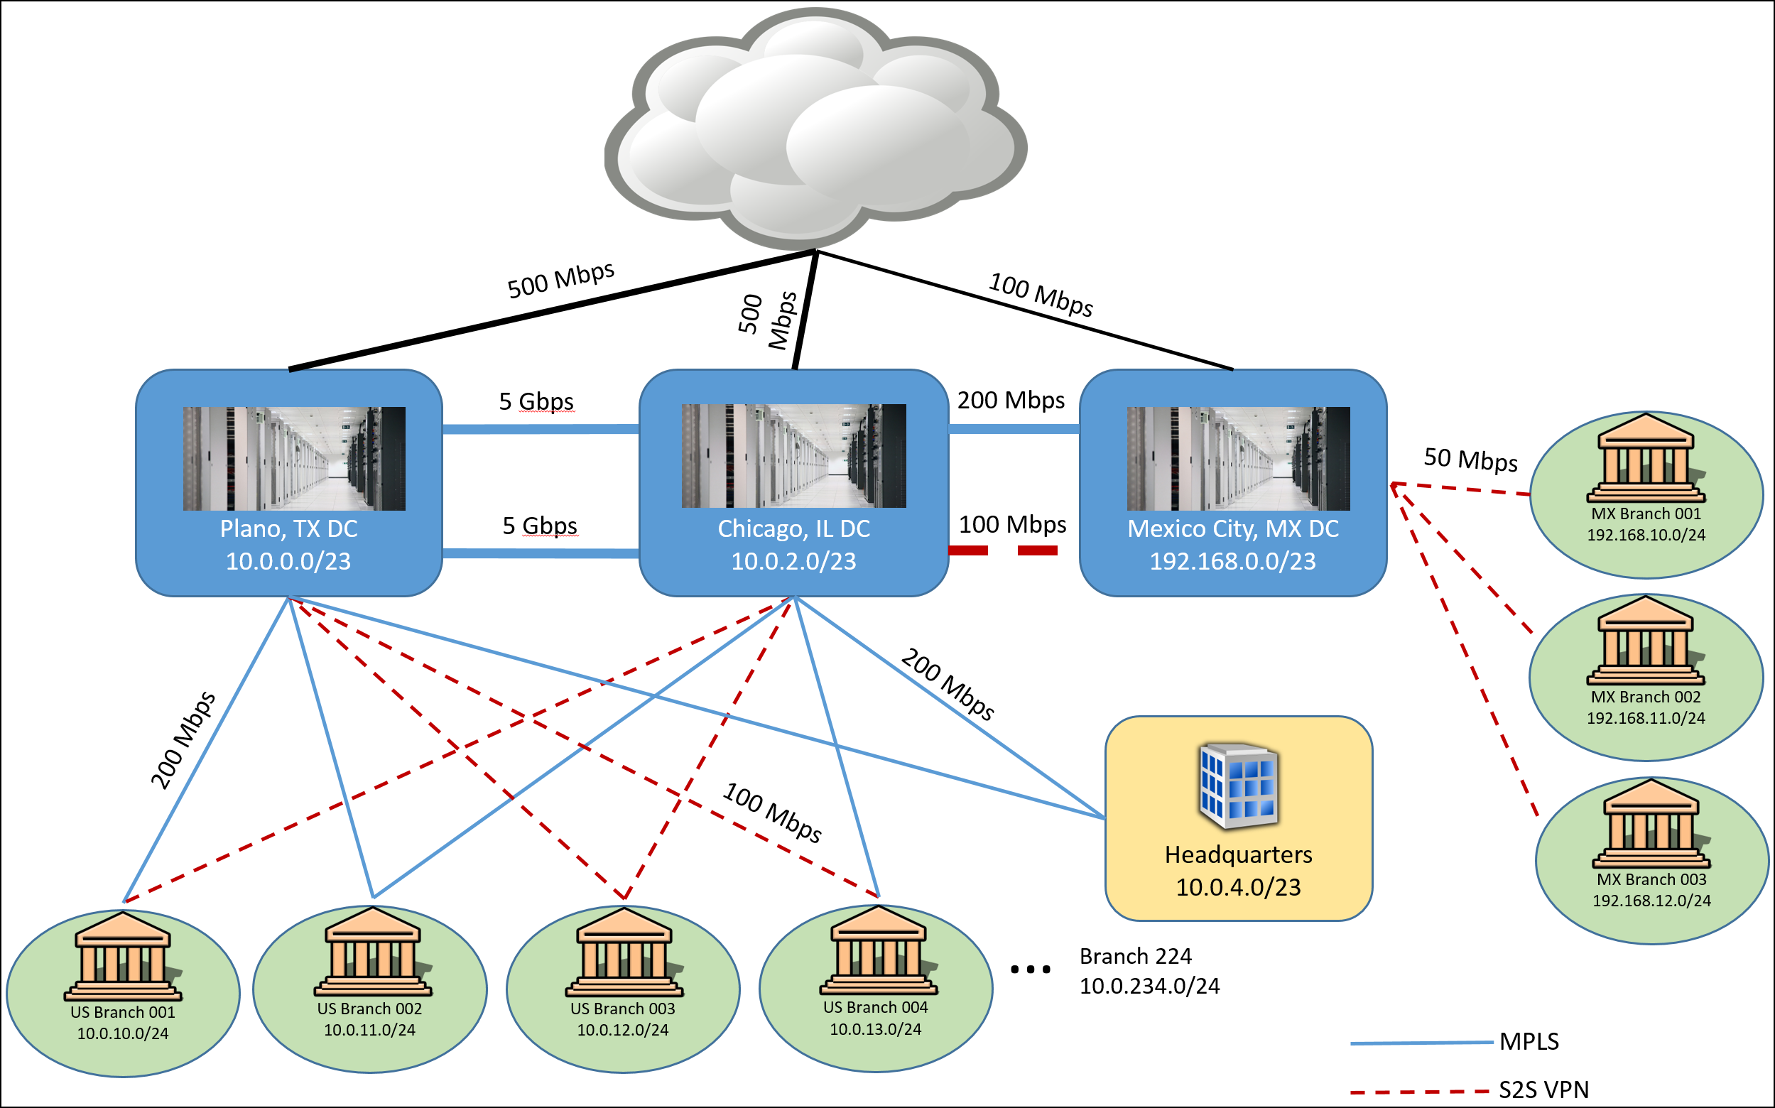
Customer situation (continued)
Notes:
United States datacenters have redundant 5 Gbps connections between them
United States branch locations to no less than 100 Mbps with each branch having connectivity to both datacenters
Mexico datacenter has an MPLS connection to the Chicago datacenter with 200 Mbps bandwidth and a Site-to-Site VPN connection for redundancy that is 100 Mbps
All 64 of the Mexico-based branches have Site-to-Site VPN connections to this datacenter and the Internet bandwidth for all branches was standardized recently at 50 Mbps up/down

Slide 10
Customer situation (continued)
Business-critical applications
Core banking application
Client-server applications
50 application servers and a SQL Server 2014-based data tier (always on availability groups and in-memory tables).
Banking website
Enables online banking
Running on web farm in the company’s perimeter network and securely interacting with the banking application servers.

Slide 11
Customer situation (continued)
Business-critical applications
HR system
Custom-written; capitalizing on several application servers and an Oracle-based data tier.
Email
Exchange Server 2010; capitalizing on DAGs that span their 2 datacenters.

Slide 12
Customer situation (continued)
Pilot application running on cloud
A new application running fully on cloud will be used as their new marketing site.
A cloud-native security solution is required.
The application must be fully isolated from their business-critical applications.
The application should use PaaS rather than IaaS.

Slide 13
Customer needs
Detailed architecture and plan for providing robust, secure connectivity between their datacenters and Azure.
Azure Virtual Networking architecture and plan for providing an enterprise-class networking scenario, supporting secure data flow between tiers in an n-tier application.

Slide 14
Customer needs (continued)
End result is a network design that allows applications to run both on-premises and in Azure.
Outbound Internet traffic must be passed through an on-premises intrusion detection/prevention system in order to comply with company policy.
Also all the incoming web traffic needs to be inspected in order to make sure it blocks SQL injections, cross-site scripting and other web attacks such as http protocol violation.

Slide 15
Customer needs (continued)
For the new cloud application, related PaaS services need to be deployed in order to run the application.
Traffic going to the new application will not be redirected to the on-premises corporate network.
Instead, Woodgrove are looking to deploy a cloud-native security solution for this pilot.
The web app architecture requires URL-based routing, redirection, and SSL termination.

Slide 16
Customer objections
Tight regulatory compliance requirements:
Security must be a key tenant of all operations including those related to technology.
CSO is opposed to using services solely accessible over the public Internet (Office 365, CRM, and other Microsoft SaaS are off limits).
PaaS services accessible over the Internet are also unusable.
Relegated Woodgrove to “private” Azure services such as IaaS.

Slide 17
Customer objections (continued)
Director of Network Operations believes complex “Enterprise-grade” networking scenarios cannot be deployed in hyper-scale public clouds.
Director of Network Operations requires that engineers have the ability to analyze traffic flows and capture packets when needed.
Need to provide detailed solution plans, case studies, and customer testimonials to help better understand.

Slide 18
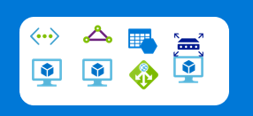
Common scenarios
Azure Infrastructure as a Service (IaaS)
Virtual machines
Virtual networks
VPN gateway
Virtual appliances
Hybrid connectivity
Load balancers
Storage
Web Application firewall

Slide 19
Step 2: Design the solution
Outcome
Design a solution and prepare to present the solution to the target customer audience in a 15-minute chalk-talk format.
Timeframe
60 minutes
Business needs (15 minutes) | Respond to questions outlined in your guide and list the answers on a flipchart.
Design (35 minutes) | Design a solution for as many of the stated requirements as time allows. Show the solution on a flipchart.
Prepare (15 minutes) | Identify any customer needs that are not addressed with the proposed solution. Identify the benefits of your solution. Determine how you will respond to the customer’s objections. Prepare for a 15-minute presentation to the customer.

Slide 20
Step 3: Present the solution
Outcome
Present a solution to the target customer in a 15-minute chalk-talk format.
Timeframe
30 minutes (15 minutes for each team to present and receive feedback)
Directions
Pair with another table.
One table is the Microsoft team and the other table is the customer.
The Microsoft team presents their proposed solution to the customer.
The customer asks one of the objections from the list of objections in the case study.
The Microsoft team responds to the objection.
The customer team gives feedback to the Microsoft team.

Slide 21
Wrap-up
Outcome
Identify the preferred solution for the case study.
Identify solutions designed by other teams.
Timeframe
15 minutes

Slide 22
Preferred target audience
Director of Network Operations
Corporate Security Officer
Corporate Compliance Officer

Slide 23
Preferred solution
The solution for Woodgrove involves several technologies, including:
ExpressRoute with private and Microsoft peering with route filters, enabling connectivity to VMs and Vnets.
End-to-end encryption of the ExpressRoute traffic enabled by next generation firewalls (NGFW) on both sides of the ExpressRoute connection.
Just-in-time access for remote administration of “jump box”.
Notes:
https://docs.microsoft.com/en-us/azure/networking/networking-virtual-datacenter

Slide 24
Preferred solution (continued)
An enterprise-class configuration within an Azure Virtual Network to support a 3-tier application. Components of this solution include:
Two Virtual Networks configured in a hub-spoke topology.
Multiple subnets for the hub and spoke
Hub – Gateway, Perimeter, Management
Spoke – Web tier, Business tier, Data tier
Two NGFWs (NGF), configured in an HA pair, providing hybrid connectivity support and internal firewall capabilities internal to the Azure Vnet.

Slide 25
Preferred solution (continued)
Five Route Tables associated with their corresponding subnets, each with specific user-defined routes configured.
Five network security groups associated with their respective subnets, each with specific allow/deny rules configured.
Four internal Azure load balancers to direct load to the primary NGFW and to servers in each application tier.
One Azure web application firewall that will protect and inspect incoming traffic.

Slide 26
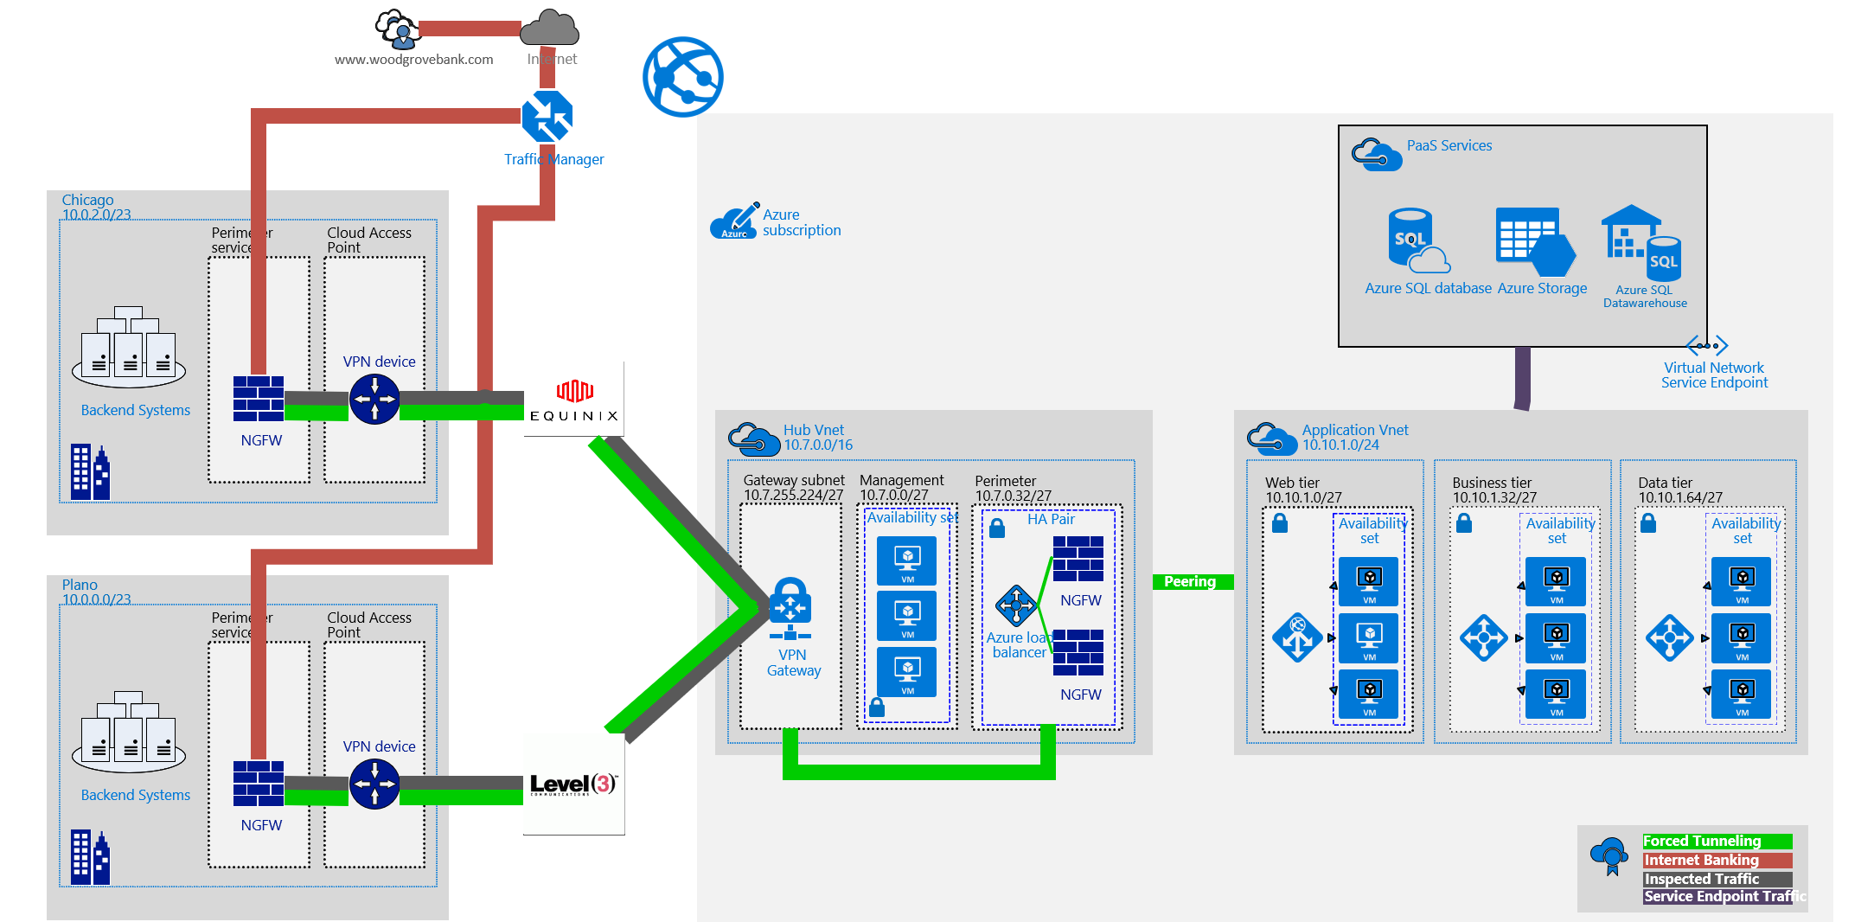
Preferred solution (continued)

Slide 27
Preferred solution (continued)
ExpressRoute configuration details:
Two ExpressRoute circuits will be provisioned:
First in Dallas, TX (corresponding to the Plano, TX datacenter)
Level 3 is the communications provider
Second in Chicago, IL (corresponding to Chicago, IL datacenter)
Equinix is the connectivity provider
Capitalizing on different providers will enable Woodgrove to maintain connectivity to Azure even in the case of a catastrophic provider issue.
After study, the unlimited licensing option with 1 Gbps was chosen for both ExpressRoute circuits. The use of a Microsoft peering path necessitates an ExpressRoute standard SKU at minimum.
Notes:
Information in this document, including URL and other Internet Web site references, is subject to change without notice. Unless otherwise noted, the example companies, organizations, products, domain names, e-mail addresses, logos, people, places, and events depicted herein are fictitious, and no association with any real company, organization, product, domain name, e-mail address, logo, person, place or event is intended or should be inferred. Complying with all applicable copyright laws is the responsibility of the user. Without limiting the rights under copyright, no part of this document may be reproduced, stored in or introduced into a retrieval system, or transmitted in any form or by any means (electronic, mechanical, photocopying, recording, or otherwise), or for any purpose, without the express written permission of Microsoft Corporation.
Microsoft may have patents, patent applications, trademarks, copyrights, or other intellectual property rights covering subject matter in this document. Except as expressly provided in any written license agreement from Microsoft, the furnishing of this document does not give you any license to these patents, trademarks, copyrights, or other intellectual property.
The names of manufacturers, products, or URLs are provided for informational purposes only and Microsoft makes no representations and warranties, either expressed, implied, or statutory, regarding these manufacturers or the use of the products with any Microsoft technologies. The inclusion of a manufacturer or product does not imply endorsement of Microsoft of the manufacturer or product. Links may be provided to third party sites. Such sites are not under the control of Microsoft and Microsoft is not responsible for the contents of any linked site or any link contained in a linked site, or any changes or updates to such sites. Microsoft is not responsible for webcasting or any other form of transmission received from any linked site. Microsoft is providing these links to you only as a convenience, and the inclusion of any link does not imply endorsement of Microsoft of the site or the products contained therein.
© 2017 Microsoft Corporation. All rights reserved.
Microsoft and the trademarks listed at https://www.microsoft.com/en-us/legal/intellectualproperty/Trademarks/Usage/General.aspx are trademarks of the Microsoft group of companies. All other trademarks are property of their respective owners.

Slide 28
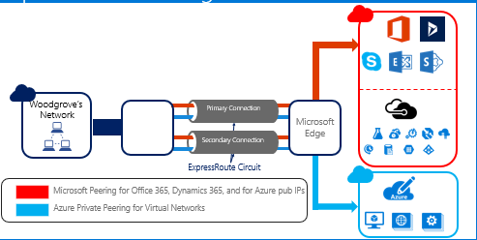
Preferred solution (continued)

Slide 29
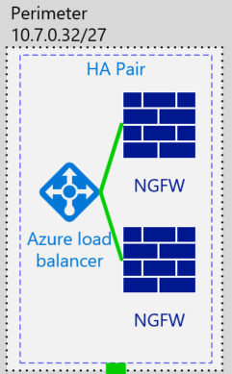
Preferred solution (continued) Network Virtual Appliances
Two next-generation firewalls (NGFW) configured in a HA Pair in an Azure availability set.
Deployed into a Perimeter subnet .
Filter traffic coming in from the Internet and from the on-premises environment.
User-defined routes are leveraged to forward traffic through the devices for inspection.
Meets the client’s requirements to use this vendor.

Slide 30
Preferred solution for cloud-based application
Azure web apps will be configured and used, to run the marketing application pilot.
Application GW running as a WAF will be used as the security solution. It will also provide URL-based routing, redirection, and SSL termination .
The Azure Web App will be configured as backend back-end pool member of Application GW.
To ensure end users will hit the App Gw, a CNAME record can be used to point to the public endpoint of the application gateway.
To create the alias, it needs Public IP Address and DNS name attached to the App Gw.

Slide 31
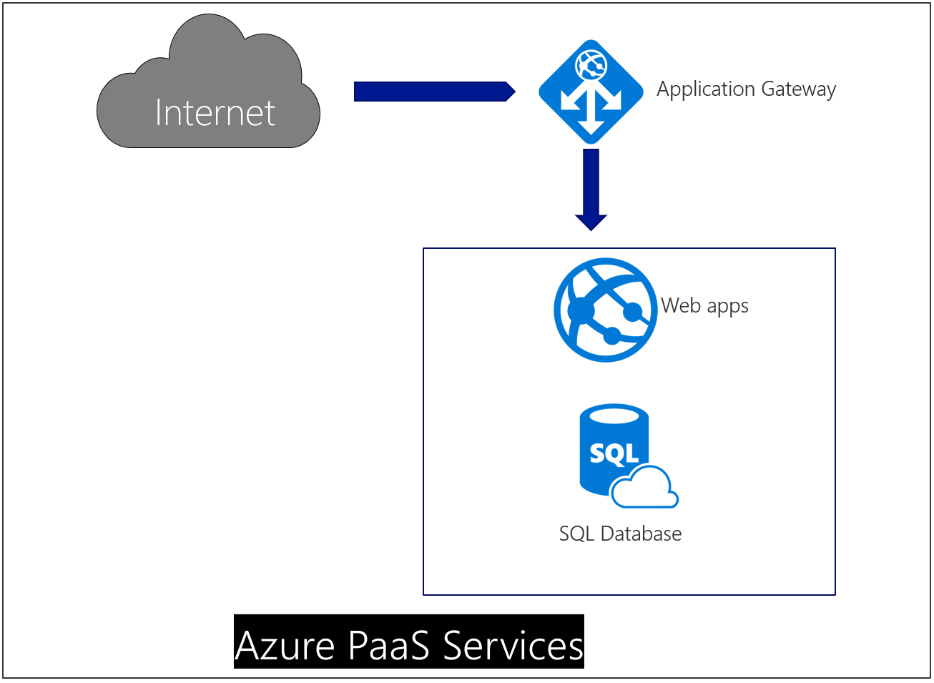
Cloud Web App Deployment

Slide 32
Preferred objections handling
Objection
As a financial institution, Woodgrove is under tight regulatory compliance requirements. Security is a key aspect of compliance and as such, it must be a key tenant of all operations including those related to technology. The corporate security officer is generally opposed to using services solely accessible over the public Internet. Services like Office 365, CRM, and other Microsoft SaaS offerings are off limits. Additionally, PaaS services accessed over the Internet are also unusable. It has relegated Woodgrove to private Azure services such as IaaS.
Potential answer
Using ExpressRoute, Woodgrove can access and use Azure private and public services without traversing the Internet. This secure connectivity, in addition to the business-class SLAs and greater bandwidth, make ExpressRoute a compelling offering that addresses this objection.
This can be further refined with the use of Virtual Network Service endpoints with offerings such as Azure SQL

Slide 33
Preferred objections handling
Objection
The director of Network Operations is under the impression that complex enterprise-grade networking scenarios, such as those that support n-tier applications, cannot be configured in hyper-scale public clouds. Trust comes slowly with this director. She will most likely need detailed solution plans, case studies, and even customer testimonials to help convince her of the viability of anything other than simple networking scenarios in Azure.
Potential answer
Azure supports many technologies that enable complex networking scenarios:
Internal and external load balancers
Network security groups for traffic filtering
Complex routing rules
Network virtual appliances from well-known vendors like Barracuda, Cisco, and Checkpoint, etc.

Slide 34
Preferred objections handling
Objection
The director of Network Operations also does not trust cloud security. She will need a strategy in place which allows Network Engineers the ability to analyze traffic flows and capture packets when needed for cloud-hosted resources.
Potential answer
Azure fully supports forced tunneling ensuring that all Internet traffic is directed to the desired site, be that in an Azure Virtual Network or on-premises.
All Internet traffic can easily be routed from Azure to an on-premises appliance for intrusion detection/prevention and logging.

Slide 35










Preferred objections handling
Objection
The corporate compliance officer of Woodgrove must ensure compliance with many requirements to ensure his organization passes audits from both internal and external entities. One requirement is all outbound Internet requests must pass through an on-premises system that inspects and logs this traffic. The CCO is skeptical of IaaS solutions in Azure since "those VMs in the cloud can access the Internet directly.“
Potential answer
The Azure Marketplace has hundreds of solutions from many different vendors.

Slide 36
Preferred objections handling
Objection
Woodgrove has an arduous process for testing vendor-supplied solutions. In the network space, they have standardized on 3rd party solutions for network and application firewalls with existing vendors. They would like to use their trusted vendors to support cloud-based configurations as much as possible.
Potential answer
Azure supports packet capture through Network Watcher.
Azure has full diagnostic support for traffic flows when network security groups are implemented with NSG flow logs.

Slide 37
Customer quote
Quote from the Network Director:
“Azure’s advanced networking capabilities and support for partner solutions are a welcome surprise. Your proof of concept has clearly demonstrated the platform's ability to more than satisfy our complex requirements.”

